Slide 1
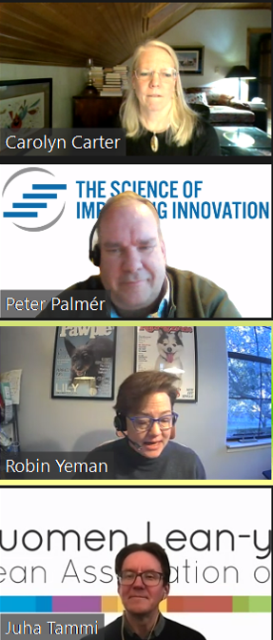
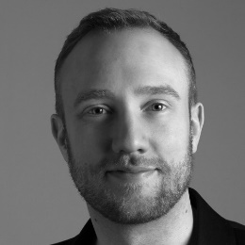
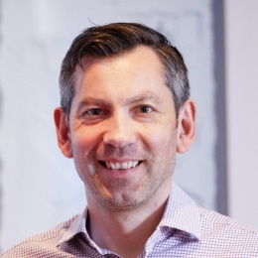
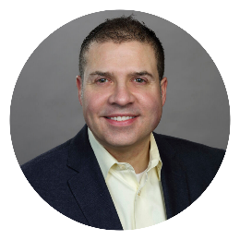
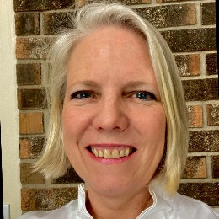
Virtual Summit 2024
Thursday May 2, 2024 1pm-5pm GMT: Conference using ZOOM
1pm GMT | Welcome – Peter Palmér, LPPDE & Juha Tammi, Lean Association of Finland
1:05pm- | Fredrik Viljesjö, We Are Movement – Continuous Industrialization - Increasing the Speed of Innovation by Integrating Product and Production Development
1:45pm- | Short break
1:50pm- | Matthew Skelton, CEO and co-author – Team Topologies: Core Agility for the Self-steering Organization
2:30pm- | Breakout rooms - Reflections and interaction
2:40pm- | Knowledge Exchange - Sharing the reflections
2:50pm- | Break
3:05pm- | Robert Snyder, Director Sales Force Effectiveness and Founder – A Modern Manifesto
3:45pm- | Short break
3:50pm- | Carolyn Carter, Carolyn Carter Consulting – Essentially - What is LPPD?
4:30pm- | Breakout rooms - Reflections and interaction
4:40pm- | Knowledge Exchange - Sharing the reflections
4:50pm- | Final reflections and remarks
5:00pm | End
REGISTRATION FEE for one LPPDE Digital Summit: 99 € / three summits €250 / or all year €700
Registrations through Lean Association of Finland: https://www.lyyti.in/virtualLPPDE
More information: www.lppde.org

Slide 2
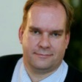
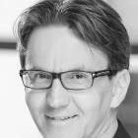
Peter Palmér, LPPDE and Juha Tammi, Lean Association of Finland
Peter and Juha represents the two organizations who organize these virtual events and will moderate the Virtual Summit.
Fredrik Viljesjö, We Are Movement – Continuous Industrialization - Increasing the Speed of Innovation by Integrating Product and Production Development
Why do we often treat product development and production system development processes as separate phases? In this talk, we start to uncover what we can learn from how Lean; Agile and DevOps methodologies have integrated the full flow from an identified customer need to a finished improved product. While there are differences between physical and digital products, we need to challenge common “truths” to keep up with competition from new companies like Tesla and other digital natives. We will discuss tradeoffs like flexibility, procurement, design lead times, functional silos and more. We will go deeper in this subject during the full-day workshop, on May 15.
Fredrik Viljesjö is one founder of We Are Movement and works as an Advisor, Enterprise Agile Coach, and DevOps/Architecture Coach with a broad and deep skill set. With 15 years of experience in development, coaching, and management, he has worked with multinational companies in Stockholm to guide them through their Lean / Agile journey.
Guiding and training development organizations to deliver value. From overall strategy and portfolio to individual development teams. He knows the whole chain of activities required for DevOps and Agile work, from getting people to collaborate better to implement a CI/CD pipelines.

Slide 3
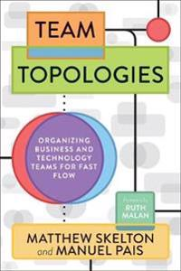
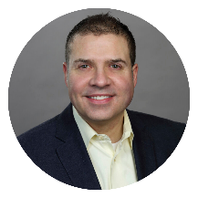
Matthew Skelton, CEO and co-author at Conflux and Team Topologies – Team Topologies: Core Agility for the Self-steering Organization
Audience: C-level and Exec teams, organization design practitioners, managers, plus people involved in the design, delivery, and operation of business-critical software systems.
Key take-aways:
The book Team Topologies points the way to profound changes for the operating model for organizations building and running software-enriched services.
Team Topologies is like yoga or pilates for the organization: core agility and situational awareness that helps to organization to achieve great things
But for the organization to be able to be more nimble and rapid, new practices, language, techniques, and mindset ended to be adopted by the organization
The growing Team Topologies ecosystem provides vital enablement for organizational transformation
Matthew Skelton is co-author of the award-winning and ground-breaking book _Team Topologies_, and Founder & Principal at Conflux. The Team Topologies book was rated one of the ‘Best product management books of all time’ by Book Authority and is widely used by organizations worldwide to transform the way they deliver value.
Matthew is one of the foremost leaders in modern organizational dynamics for fast flow, drawing on Team Topologies and related practices to support organizations with transformation towards a sustainable fast flow of value and true business agility.
A Chartered Engineer (CEng), Matthew brings together principles and practices from multiple disciplines for a holistic approach to digitally-enriched operating models. He combines his experience as a leader and software architect in multiple contexts (GOV.UK, ecommerce, financial services, telecoms, pharma, retail, robotics, etc.) with a strong interest in the human side of organizations for a compassionate and humanistic approach to organizational effectiveness.
Robert Snyder, Director Sales Force Effectiveness and Founder at TransUnion and Innovation Elegance – A Modern Manifesto
The Agile Manifesto was published in 2001 as a reaction to generally accepted software development practices in the 1990s. Twenty-three years later, the original text remains a guiding light for many.
But Agile has evolved. The Agile community saw Disciplined Agile, Scaled Agile, and most recently Business Agility. When Agile simply doesn’t fit, Hybrid is not a crime.
One strength of the manifesto is that its word choice and sentence structure are conducive to small adjustments. Twenty-three years of lessons learned have piled up. Could we rewrite the manifest here in 2024, and again in 2047?
One person tried. This session presents his writing exercise. He welcomes your feedback.
Takeaways
1. Is your status quo acceptable or even attractive?
2. Is there sufficient value in this exercise?
3. Does anything not Agile simply qualify as rigid?
4. What would you rewrite?
5. Is this rewrite superficial or profound?
Robert Snyder is the founder and president of Innovation Elegance, LLC. Robert’s thirty-year career spans roles such as developer, project management, change management, sales enablement, and the performing arts. His career path includes corporate roles, consulting roles, startups, PMP, and Agile certifications. He has performed in numerous vocal, dance, and theater ensembles. Robert earned his BS in Electrical Engineering from the University of Illinois and his MBA in Strategy from the Kellogg School of Management at Northwestern University.
Robert published his first book on New Years Day titled: “Innovation Elegance: Transcending Agile with Ruthlessness and Grace.” His second book, “Innovation Portfolio: Five Verbs Shape Your Team’s Legacy,” is due in April.

Slide 4
Carolyn Carter, Carolyn Carter Consulting – Essentially - What is LPPD?
Carolyn will look back to the basics of LPPD and give her view on what Lean Product and Process Development is.
Carolyn Carter is Principal Consultant at Carolyn Carter Consulting after an extensive career at the Kimberly-Clark Corporation where she got her experience in Research Product Development with additional focus on Lean and LPPD in Development, and Engineering, Operations and Quality in Manufacturing.
Carolyn's experience include:
Leader of Lean Product and Process Development launch across multiple Business Units
Co-lead of Lean Product and Process Development launch into Research Teams
Lean Coordinator for initial launch of Lean Culture into Research Team
Product Developer in programs across multiple businesses
Product Development Leader for commercialization of large Personal Care Program
Leadership and development of Process Optimization Program Product Supply for North America and European Personal Care
Lean Strategic and A3 Problem Solving applications as Quality Manager in Personal Care Manufacturing
Quality Manager in multiple regulated and non-regulated Personal Care Manufacturing Plants
Exchange
Following the spirit of Lean Product & Process Development EXCHANGE there will be good possibilities to Exchange knowledge with other attendees as well as with the speakers. After two presenters we have a session “Reflections and interaction” where you will reflect and interact on the learnings from the presenter.
Afterwards we hope the Exchange will continue on our LinkedIn site
The Science of Improving Innovation – LPPDE and our LinkedIn group
LPPDE - The Science of Improving Innovation
And our website www.lppde.org

