Slide 1
Ramping up New Talent…
Carolyn Carter
LPPDE 2025

Slide 3
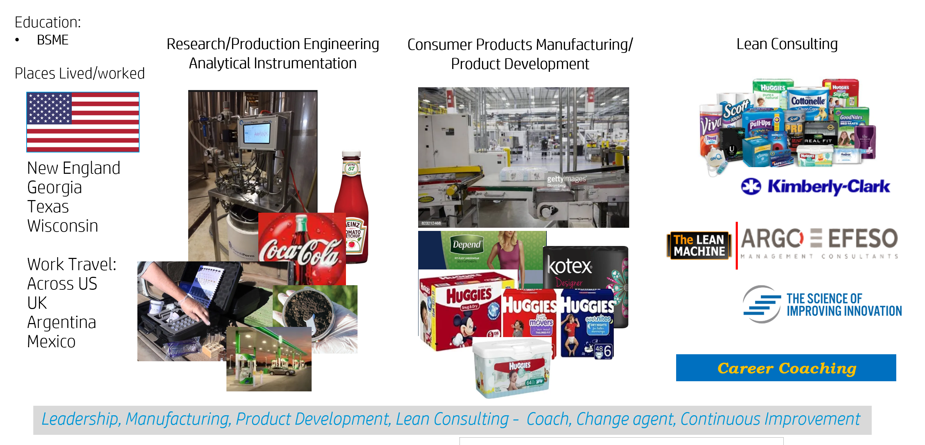





Carolyn Carter

Slide 4
Agenda
Background
Opportunities
Process
Impact

Slide 5
Status on arrival
Social
Collaborative
Energized
Curious
Motivated to Make an Impact
Eager to Learn

Slide 6
What Do They Need?
A network of other new players to grow with
Exposure and a team to work with
A clear set of objectives and goals
A challenging assignment
Opportunities and Time to explore
Work that is visible and adds value
Mentors to coach and develop them

Slide 7
What Happens If They Don’t Get These?
They get demotivated
They lose interest
They lose their curiosity
The don’t feel valued
Their desire to learn wanes
They drift
They look to other teams to meet their needs

Slide 8
Typical Assignments
Onboarding may be super slow –ramp up may be complex
Assignments to Studies
Slow engagement with a current program
Special Projects
What’s wrong with these?
Not Challenging Enough
Project doesn’t provide enough exposure and value
The work doesn’t feel valuable
May not see the end result

Slide 9
What is the goal in development for a Technical Team member?
Teams of Responsible Experts
  If we align to the definition of a Responsible Expert the key skills align to:
    Highly collaborative team player
    Strong Leadership Skills
    System Perspective/Awareness
    Understanding of key processes and their role as part of them
    Deep Technical Expertise in a specific area
    Ability to understand and resilience as they adapt to program changes and new learning as they practice LAMDA
Chief Engineer
  Identification of potential

Slide 10
How Can LPPD Enable Success in Delivering that Goal?
Exposure to development of Functional and System Breakdowns
Engagement in development and execution of the Program Learning Plan
Involvement in Visual Management
Empowerment to use and build Reuseable Knowledge

Slide 11
Exposure to the Functional Breakdown
Fly Passengers
Pilot Machine
Control Machine
Lift Passengers
Propel Passengers
Launch Machine
Land Machine
Test
Machine
Control altitude
Control direction
Control attitude
Contain Pilot
Connect Pilot to Controls
Connect Controls to Machine
Contain Passengers
Store Power
Release Power
Transmit Power to Air

Slide 12
Exposure to the Functional Breakdown
Provides a foundation in the product architecture and functionality
Visibility to the whole team learning at the same time, building confidence they are all learning together as a team
Exposure to all the participants in the meeting – Product Leaders, Product Scientists, Technical Leaders, Program Managers, etc. allows for hearing deep levels of experience and multiple perspectives, and an opportunity to build relationships with the whole team
Maintaining a very safe environment for learning and curiosity… nurtures the asking of questions from fresh eyes, and the opportunity to begin to build credibility, as everyone begins to appreciate who they are and what they begin to offer

Slide 13
Engagement in the development and execution of the Program Learning Plan
Key Opportunities for Learning through the Program Planning process…
Participation in the Hypothesis and Metrics Build
Participation in the Learning Plan Build
Ownership of parts of the Learning Plan

Slide 14
Building the Hypothesis
The new player gets to see and meet the full business team, has a chance build rapport,
Gains insight into the process of alignment of these teams, which can be very challenging and drive rich discussion
Exposure to the full picture surrounding the program, hearing the business side as well as the technical side
Participation in the development of the hypothesis, they feel part of the program planning from the very start, building investment and deeper understanding

Slide 15
the Program Plan, involves identification and sequencing, of the Key Decisions across all of the swimlanes
Participation in the Learning Plan Build
Swimlane
W
E
E
K
L
Y
I
N
T
E
G
R
A
T
I
O
N
E
V
E
N
T
S
Program
IE1
IE2
IE3
IE4
IE5
IE6
IE7
Risks
Markekting
D1
Sales
D13
D4
D10
D2
Finance
Syst 1
D14
D11
D6
Syst 2
D9
Syst 3
D5
Quality
D8
Manuf
D13
Sup Chn
D7
D3
Notes:
Swimlanes represent each team who supports the Program, no matter what part of the business they are from
Blue boxes across the top - represent the weekly Integration Events scheduled for all the meetings for all the programs in the department.
The Critical Decisions are laid out from the last point where the critical decision is able to be made backwards, taking into account all swimlanes. Each swimlane will develop their list of critical decisions
Then the interdependencies between them will be identified and they will be sequenced accordingly.
Each critical decision or set of decisions will be aligned to an integration event. For example in IE1 – the critical decisions coming out of Sales, System 1 and Manuf will be reviewed and decided. In IE2 – the Critical Decisions for Finance and System 2 will be reviewed and decided, ETC.
In addition, any risks the team believes need to be captured, need to be captured and visible.

Slide 16
Identification of the required knowledge gaps for each decision
Participation in the Learning Plan Build
Swimlane
W
E
E
K
L
Y
I
N
T
E
G
R
A
T
I
O
N
E
V
E
N
T
S
Program
IE1
IE2
IE3
IE4
IE5
IE6
IE7
Risks
Markekting
D1
D1
Sales
D13
D4
D13
D4
D10
D10
D2
Finance
D2
D14
D11
D14
D11
D6
Syst 1
D6
D9
Syst 2
D9
D5
Syst 3
D5
D8
Quality
D8
D13
Manuf
D13
D3
D7
D3
Sup Chn
D7
Knowledge Gap
Notes:
Swimlanes represent each team who supports the Program, no matter what part of the business they are from
Blue boxes across the top - represent the weekly Integration Events scheduled for all the meetings for all the programs in the department.
The Critical Decisions are laid out from the last point where the critical decision is able to be made backwards, taking into account all swimlanes. Each swimlane will develop their list of critical decisions
Then the interdependencies between them will be identified and they will be sequenced accordingly.
Each critical decision or set of decisions will be aligned to an integration event. For example in IE1 – the critical decisions coming out of Sales, System 1 and Manuf will be reviewed and decided. In IE2 – the Critical Decisions for Finance and System 2 will be reviewed and decided, ETC.
In addition, any risks the team believes need to be captured, need to be captured and visible.

Slide 17
Identification of the supporting experimentation required for each of the knowledge gaps
Participation in the Learning Plan Build
Swimlane
I
N
T
E
G
R
A
T
I
O
N
E
V
E
N
T
S
Program
IE1
IE2
IE3
IE4
IE5
IE6
IE7
Risks
Markekting
D1
D1
D13
D4
Sales
D13
D4
D10
D10
D2
Finance
D2
D11
D14
D11
D14
D6
Syst 1
D6
D9
Syst 2
D9
D5
Syst 3
D5
D8
Quality
D8
D13
Manuf
D13
D7
D3
Sup Chn
D7
D3
Knowledge Gap
Experiment/Research/Simulation
Notes:
Swimlanes represent each team who supports the Program, no matter what part of the business they are from
Blue boxes across the top - represent the Integration Events (Weekly Cadence for All Programs) scheduled for all the meetings for all the programs in the department.
The Critical Decisions are laid out from the last point where the critical decision is able to be made backwards, taking into account all swimlanes. Each swimlane will develop their list of critical decisions
Then the interdependencies between them will be identified and they will be sequenced accordingly.
Each critical decision or set of decisions will be aligned to an integration event. For example in IE1 – the critical decisions coming out of Sales, System 1 and Manuf will be reviewed and decided. In IE2 – the Critical Decisions for Finance and System 2 will be reviewed and decided, ETC.
In addition, any risks the team believes need to be captured, need to be captured and visible.

Slide 18
Participation in the Learning Plan build
Allows for understanding of team roles, and insight into the development of the program plan from both a business and technical perspective.
Identification of the interdependencies across all the swimlanes enables appreciation that their work impacts the work of other program teams, introducing a system perspective, reinforcing collaborative skills, and a focus on how to make all the swimlanes successful
Exposure to the decision/knowledge gap and experiment relationships provides a line of sight to their objectives and goals as they take leadership of closing a knowledge gap and and the required research to do so

Slide 19
Ownership of Knowledge Gaps and Experiments
Leadership of the development, execution and interpretation of the experiments to close the knowledge gap and the power to influence adjustments in the learning plan, provides an opportunity for deep understanding of their area of research, enabling them to become the expert
Repeatedly applying the scientific method, allows for internalization of it’s value in learning and delivering knowledge to the business
Generating knowledge which causes deviations from the plan they can see how the program and business teams react
Coaching on the application of knowledge from previous experimentation, testing to limits and the importance of doing the research before doing the design work, enables awareness and learning of fundamental LPPD principles

Slide 20
Ownership of Knowledge Gaps and Experiments
Clarity of purpose and a clear process, allow for focus on valuable work – learning and researching vs running around trying to figure out who to talk to answer questions
Participation in the Learning Cycle Events and building Technical A3’s and Knowledge Briefs teaches the documentation process and how to capture visual knowledge
Articulating their work, exposure to receiving and providing catchball, provides practice in communicating succinctly, gradually building their credibility
Coaching to make results from experiments visual, and then converting observations in to knowledge and making conclusions strengthen analytical skills
Delivery of work on a cadence, builds discipline in how to work on a schedule

Slide 21

Participation in Visual Management
Practicing VM, provides exposure to the status of the overall program and how their work fits into it, teaches how to provide succinct updates, and how to articulate the issues holding them back
Seeing when they ask for help, they receive it quickly, because leaders were listening and responding, indicating their work was important
Seeing interactions with other swimlanes drives collaboration and system awareness
System Board
E

Slide 22
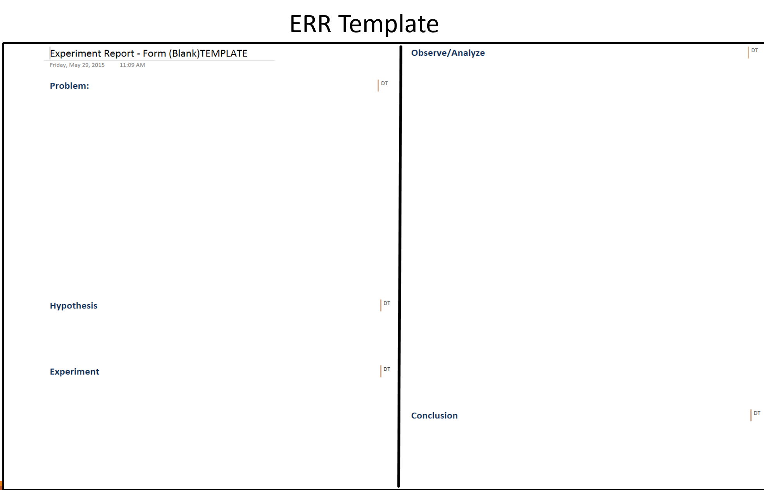
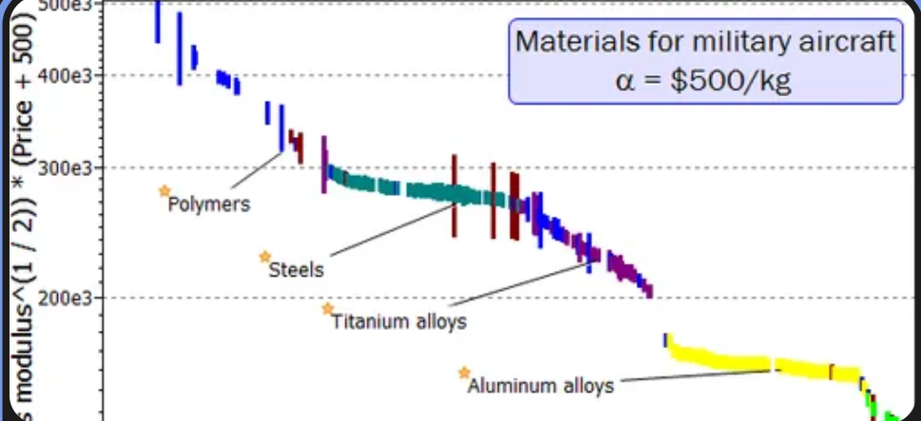
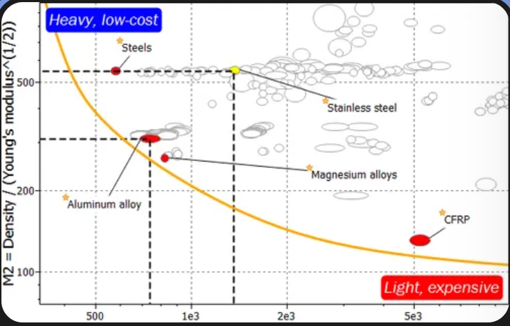
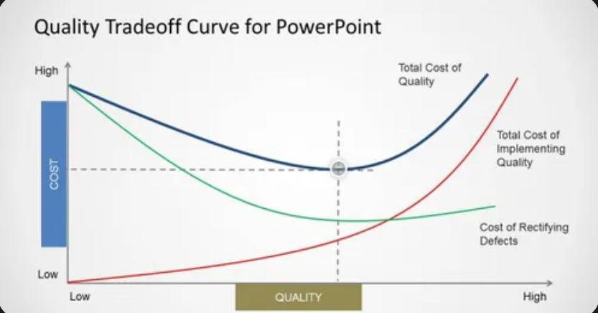
Using and Building Reusable Knowledge
Expectations for delivery of Documentation of Technical A3’s to capture results of experiments, allows for repeated practice of the scientific method
Providing and accepting feedback throughout the execution of the experiment, allows for deeper knowledge of how and why the scientific method delivers results
Additional expectations for documentation of technical A3’s to capture the results of their work, make their contributions visible, and enable others to reuse their knowledge
Building an Knoweldge brief taught them how to capture experimental knowledge in support of closing the knowledge gap, providing practice in converting data into knowledge

Slide 23
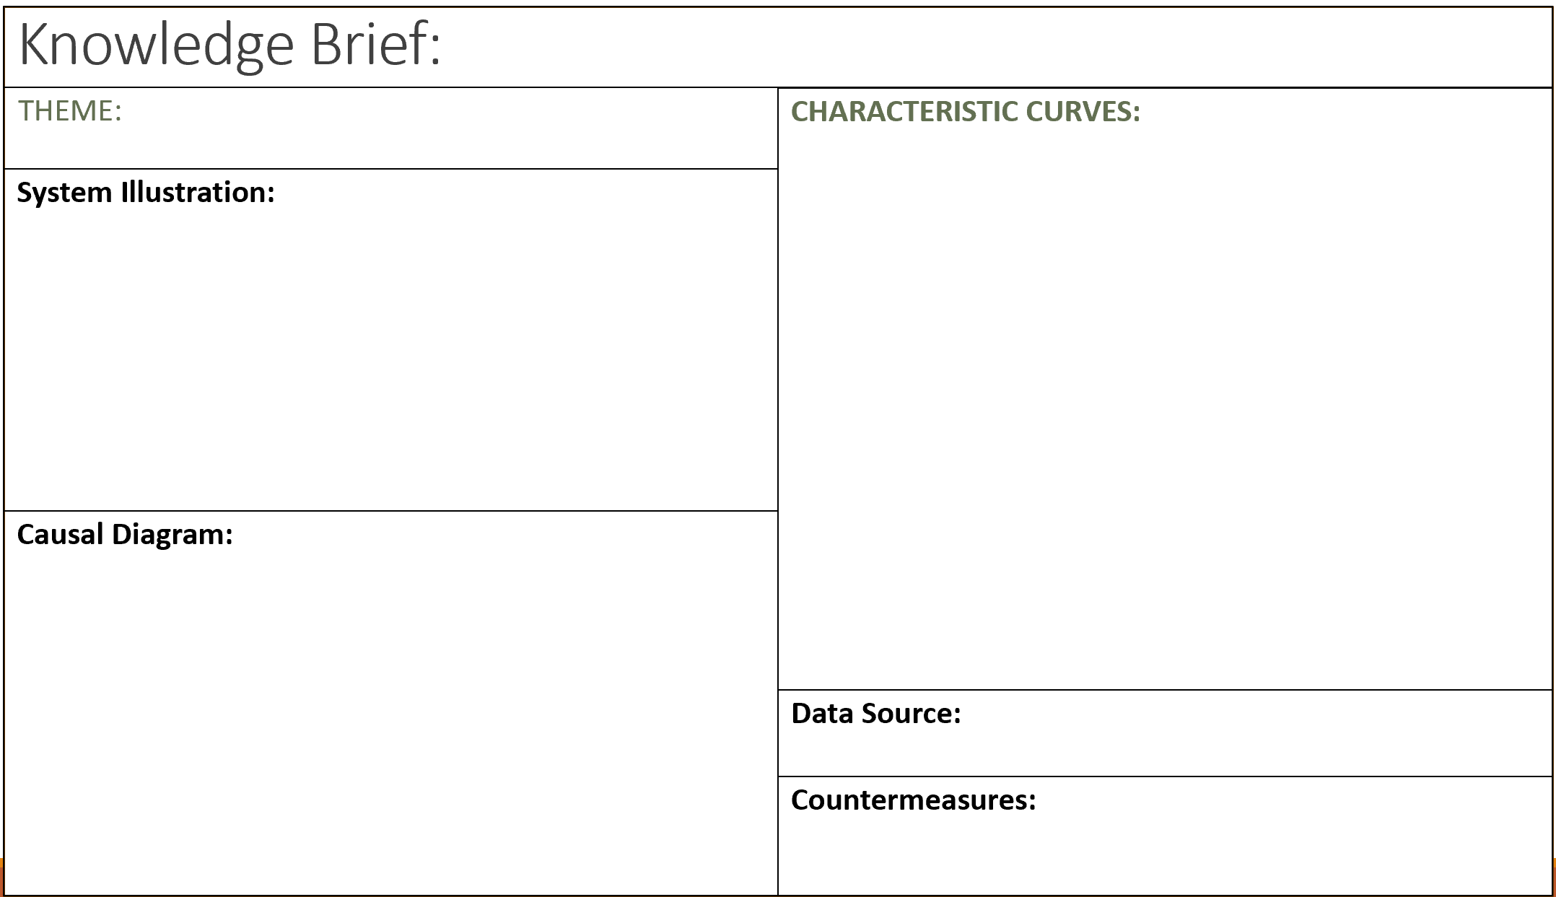
Co-OP’s end of term report out
Drew a big audience
Communication of the background of the program objectives, and clarity of their role
SharingTechnical A3’s and Knowledge Briefs representing results of their work demonstrating the value and opportunities for future reuse
Effectively answered questions
Emanated confidence, a feeling of accomplishment, and demonstrated strong communication, leadership and technical skills

Slide 24

Reflection:
Teams of Responsible Experts
  If we align to the definition of a Responsible Expert the key skills align to:
    Highly collaborative team player
    Strong Leadership Skills
    System Perspective/Awareness
    Understanding of key processes and their role as part of them
    Deep Technical Expertise in a specific area
    Ability to understand and resilience as they adapt to program changes and new learning
Chief Engineer
  Identification of potential

Slide 25
Thank you!
Questions?

